Slide 1
Theme 4 Recap: changing quality of life, 1917-80.
Quick Start:
Next to each statement, write the correct answer to make it clear what the statement is referring to.
Challenge: What are the key changes that take place between 1917-80, in leisure and travel?
Consider general trends across the time period in various areas, e.g. film, sports, tourism, car/planes.
Notes:
Heads and tails from Gay Rights +/- sheet from last week.

Slide 2
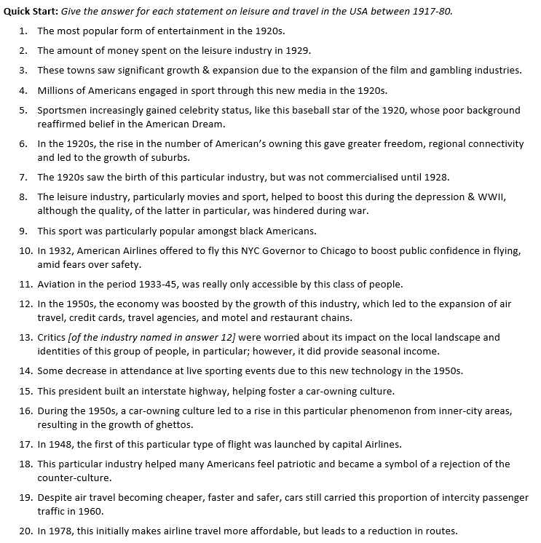
Cinema
$4bn
LA & Las Vegas
Radio
Babe Ruth
Cars
Aviation
Morale
Boxing
FDR
Wealthy (esp. businessmen)
Tourism
Native Americans
TV
Eisenhower
White flight
Coach
Sport
90%
Deregulation

Slide 3
Reagan Essay Feedback
Theme 4 Recap: changing quality of life, 1917-80.
Really good attempts for first Section C Essay.
Good understanding of extract 1.
Generally really good range of supporting contextual detail.
Well structured and all came to a judgement.
Balanced analysis of both extracts.
Not all essays understood key argument in extract 2.
Use supporting evidence to discuss the arguments, rather than simply support them.

Slide 4
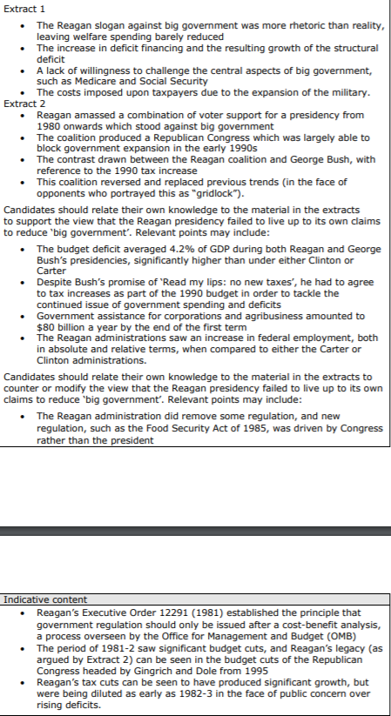
Theme 4 Recap: changing quality of life, 1917-80.
Reagan Essay Feedback
Grab the single sheet of paper you have been given.
Look at the indicative content:
what did the examiners suggest could have been included?
Is there anything obvious that you missed?

Slide 5
Theme 4 Recap: changing quality of life, 1917-80.
Reagan Essay Feedback
Grab the stapled sheets.
Look at the examiner report (first page):
What do they say made a successful response?
What should be avoided?
Based on this, what do you think you did well? Are there any mistakes that you made?

Slide 6
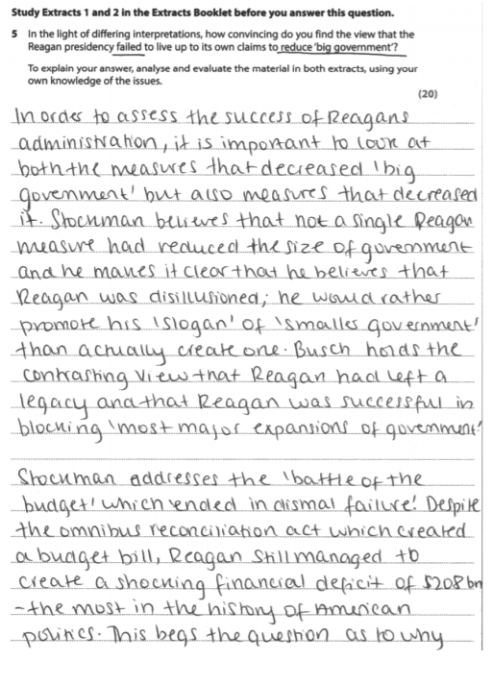
Theme 4 Recap: changing quality of life, 1917-80.
Reagan Essay Feedback
Time to look at the model response.
This particular answer received a weak Band 5.
Focus on the paragraphs that deal with extract 2. How is their discussion of the arguments different to how your own was done?

Slide 7
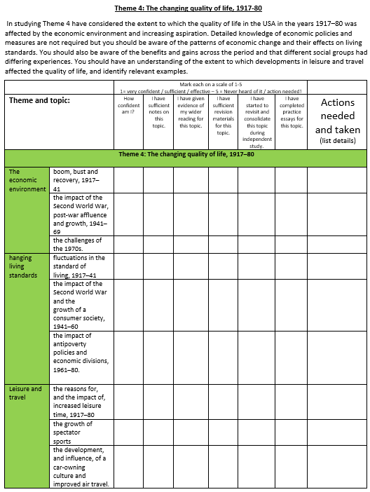
Theme 4 – Changing Quality of Life
Theme 4 Recap: changing quality of life, 1917-80.
How confident are you with this topic?
Complete the checklist to review your knowledge on this topic so far.
Remember: you have a checklist for all four themes and Reagan in your Course Guides.

Slide 8
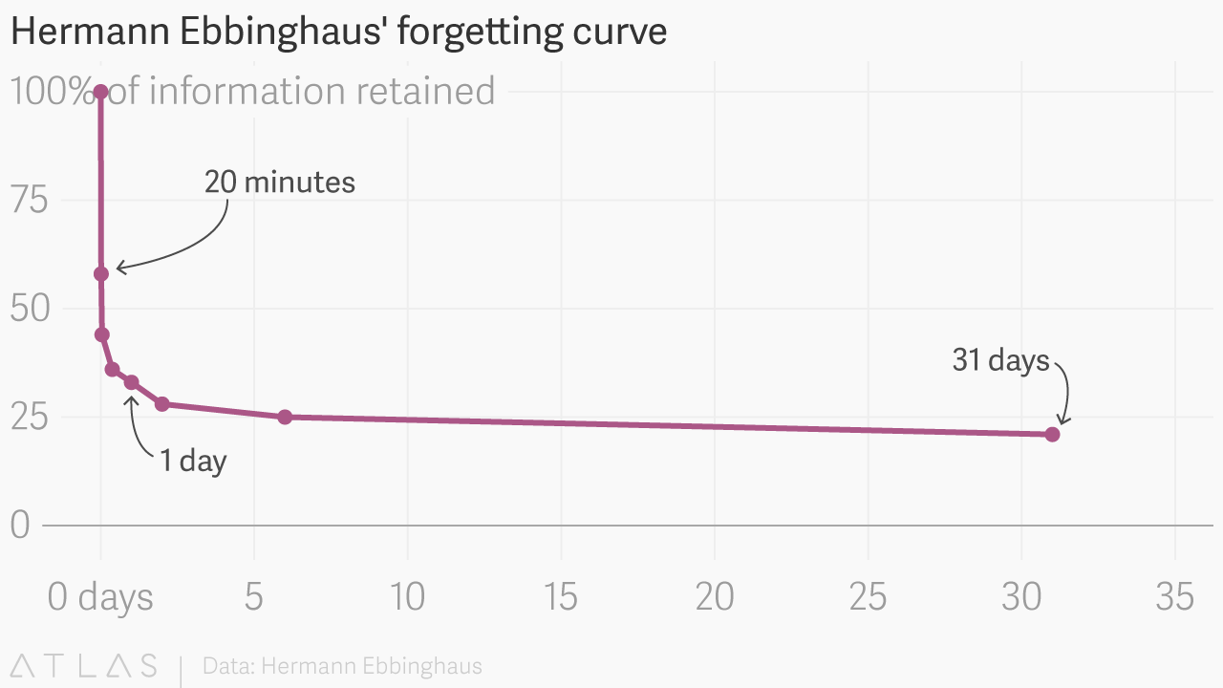

Slide 9
You should already be revising… if you aren’t start now!
Organised folders.
Revision checklists.
Revision materials.
Use them!

Slide 10
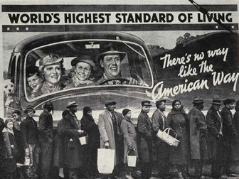
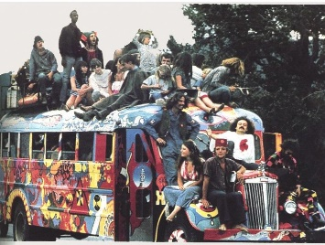
What does the Changing Quality of Life entail?
Theme 4 Recap: changing quality of life, 1917-80.
There are three main strands to focus upon:
Affluence (i.e. economy)
Standard of Living
Leisure and Travel
There is a second order concept focus on change, so arguments must link to this aspect.

Slide 11
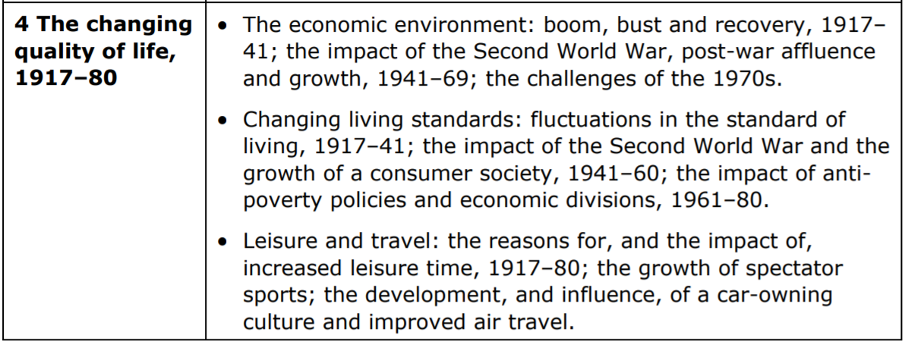
What to revise?
How and why do historians disagree over Reagan’s presidency?
Key focus areas:
Economic bust & recovery
Impact of affluence
Improvements in SoL
Impact of changes to travel
Nature of changing leisure
Most importantly, make links between factors.
How has the standard of living been affected by: affluence or war?
How has affluence impacted upon the leisure activities of Americans?
How have changes to the standard of living impacted American activities?
How have these three aspects changed over time?

Slide 12
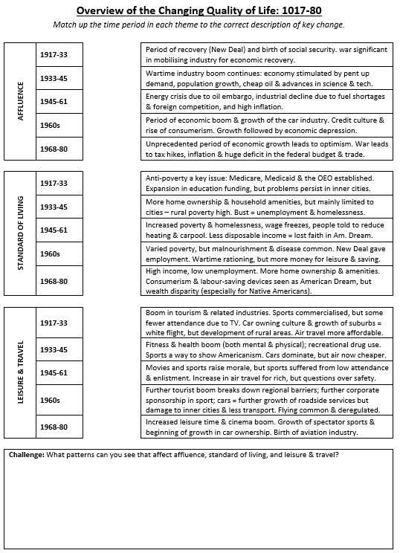
Overview of Changing Quality of Life
How and why do historians disagree over Reagan’s presidency?
Complete the match up activity on p.3 to link each time period to the correct description of the era for:
Affluence
Standard of Living
Leisure and Travel
Challenge:
What patterns can you see that affect affluence, standard of living, and leisure & travel? You have space to complete this at the bottom of the page.

Slide 13
Challenge:
What patterns can you see that affect affluence, standard of living, and leisure & travel?

Slide 14
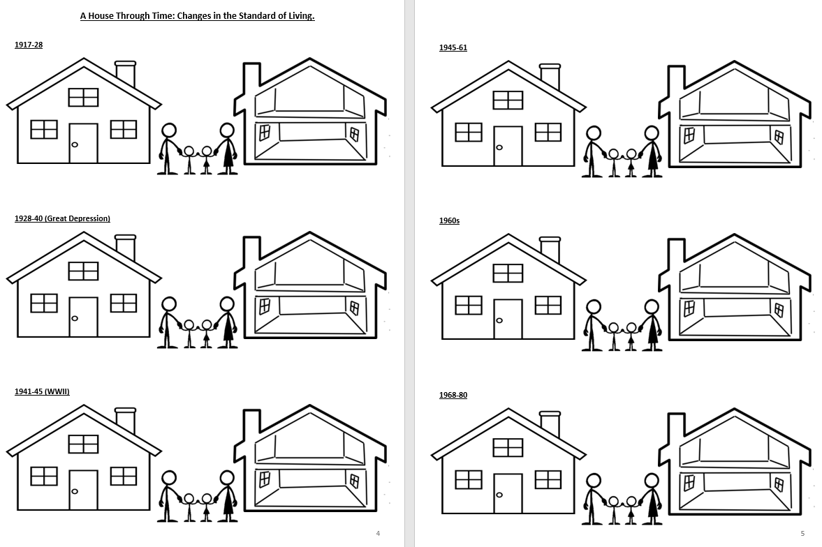
Changes in the Standard of Living
How and why do historians disagree over Reagan’s presidency?
Turn to pp.4-5 in your booklet.
For each time period, illustrate & label the house with the features and amenities you would expect to see.
You may also label the impact that this has on the family living here.
Challenge: …?

Slide 15
p.6

Slide 16
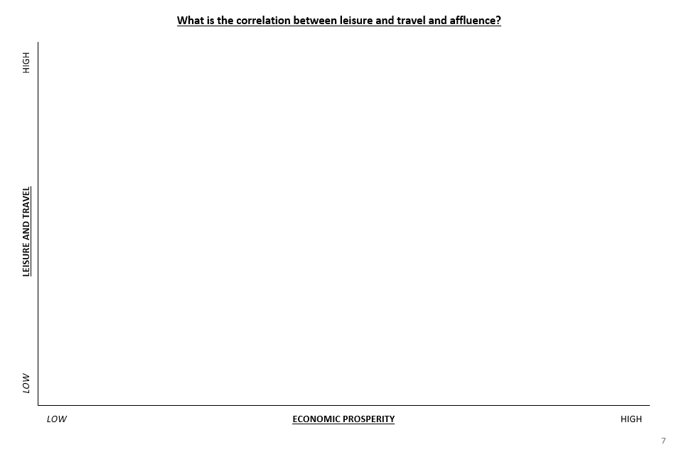
p.7

Slide 17
This is a start for revision…
… but this is not everything!!
Key focus areas:
Economic bust & recovery
Impact of affluence
Improvements in SoL
Impact of changes to travel
Nature of changing leisure
You must develop your revision beyond these examples.
Go back to the checklists & ensure you have adequate revision materials and examples for each group and key focus area.
Most importantly, make links between factors.

Slide 18
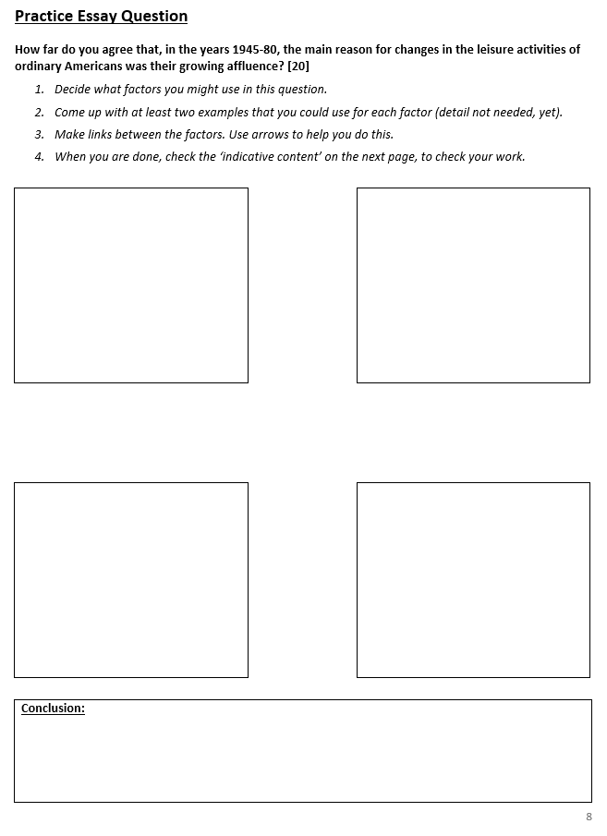
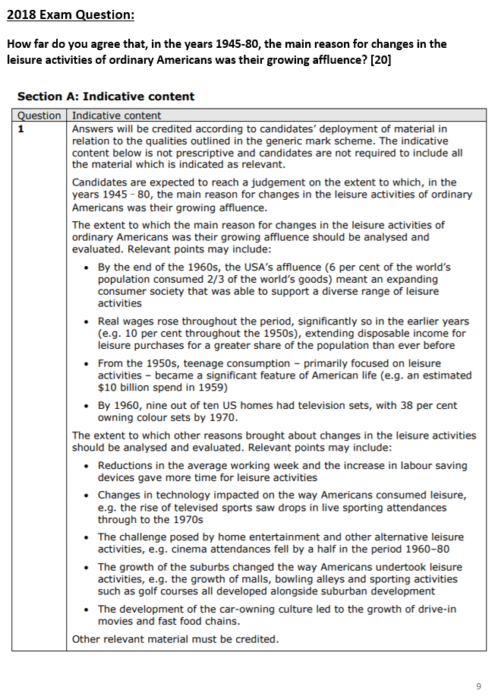
p.8
pp.9-10
CHECK YOUR WORK

Slide 19
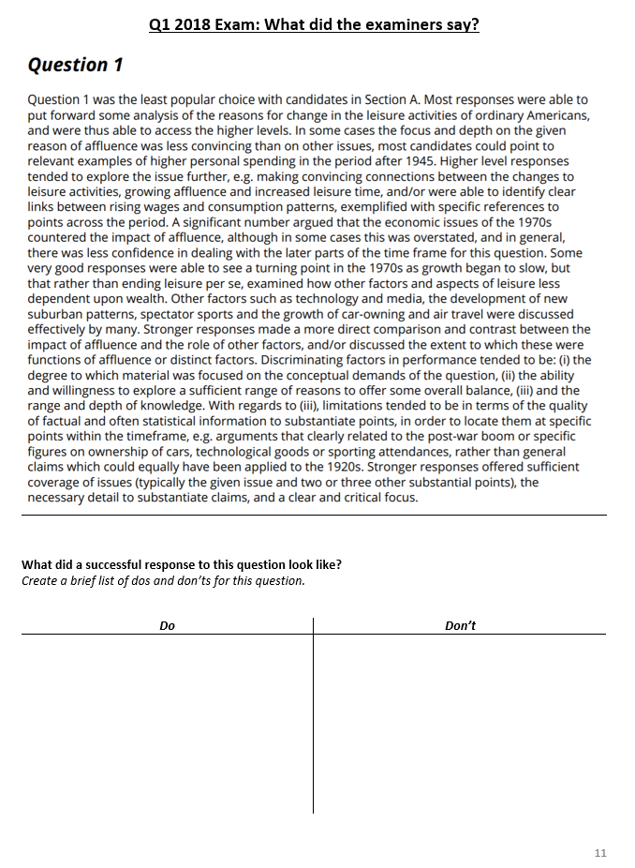
Page 11
Read the examiner report on this question.
What did they say made a strong/weak response?

Slide 20
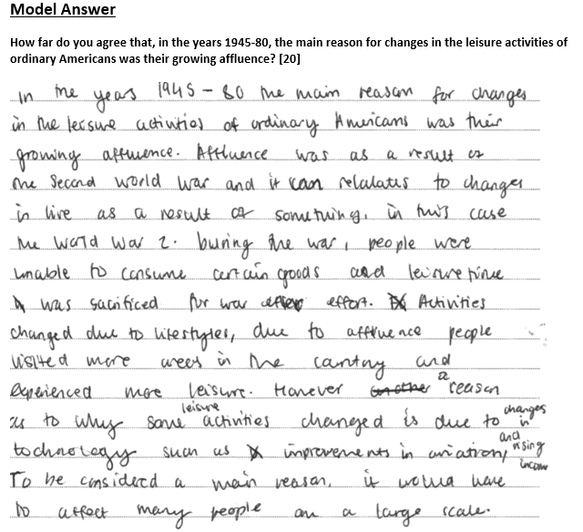
Page 12
Read the introduction to this model answer.
What makes this introduction a Level 5?

Slide 21
Planning Your Essay
How and why do historians disagree over Reagan’s presidency?
Go back to you examples.
How do you want to answer this question?
Write your own introduction to this question (it should include your brief, but clear, judgement). (You may use the structure strip to help you with this.)
Plan out how you would answer this question. (Structure, key arguments, key supporting examples.) Make sure you have a consistent judgement throughout!
Structure for factor approach should be: intro, PEEs & conclusion.
Remember, be realistic about what you can achieve in the time frame (40min).

Slide 22
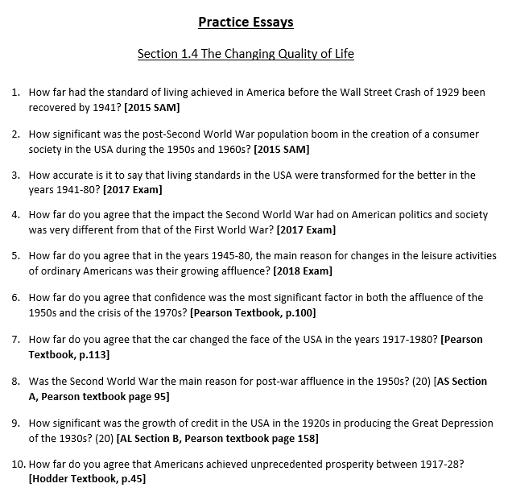
p.17

